Slide 1
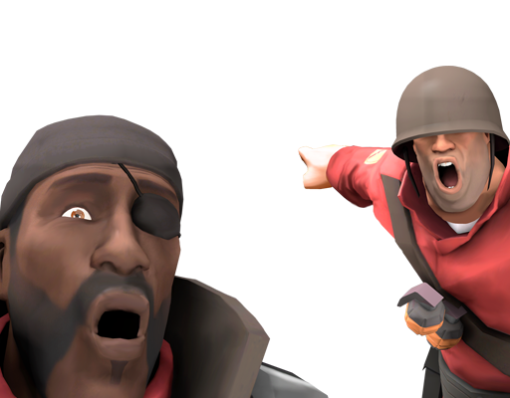
PRIVACY
Notes:
Talk about china privacy stuff - and now chinese start to figure out something and everything is already too late.
The gradual erosion of privacy did not make us more secure, it had the opposite effect of turning everybody into a suspect.
Thinking like this government can arrest you due to some comment you made years ago on a message app that you sent to your friend, and they have the evident. What can you do about ?
Or maybe you’re got lucky but they list you to a high alert persona list and everything you do they will monitor you even when you asleep.
We been teach to mindlessly giving out our data without any consent on what data they will get and how the data will be used. So that is why I want to share opinion about this topic, not to persuade you guy to think about privacy but just to give out some information and share I thought.
Talk about a child become a sexy toy on dark web and the parent can’t do any shit about it.

Slide 2
AGENDA
Why you want to be private on online ?
What is Privacy?
How you can achieve privacy online.
The tools & what do I use ?

Slide 3
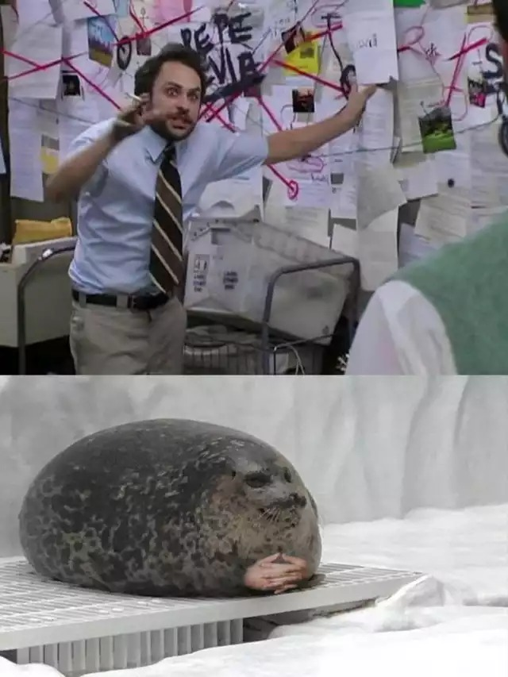

Slide 4
Why does it matter if I have nothing to hide ?
Notes:
But Eugene I have nothing to hide you might said.
The thought of any one think about privacy is doing something suspicious or illegal but then
Thinking of this if your house has curtain or a lock in the front door or a fence around your yard it’s mean you already value some form of privacy and you want to prevent people from go into your private zone.
Everybody have something to hide not just terrorists and cirminals but us always have something to hide, there are all sort of thing that we do and think that we’re willing to tell out lawyer or psychologist or family that we would not want the rest of the world knows about it.
This argument is dangerous and out of the point. Because everybody thinks they have nothing to hide but to the point it does matter it already too late to gain it back .
Some people said “privacy is not important” but do something contradicted to their believes like Mark Zuckerberg quote “Privacy is no longer a social norm“ but then in 2013 Mark and his wife bought a house but not just his house he bought 4 other residential to make his life more private without any body monitor his life.

Slide 5
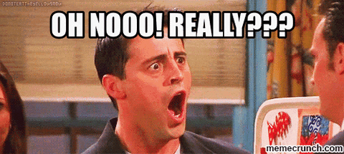
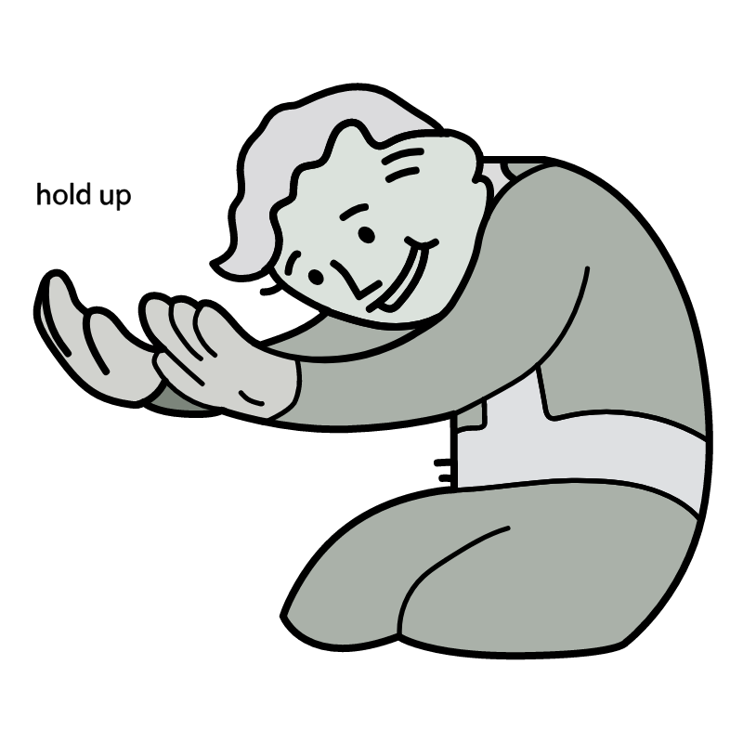
I’m using Youtube and Linkedin and Instragram !!!
Do I Just Kill everything that I just said ???????

Slide 6
Why?
01
Why do you want to be private while surfing website and using online service?

Slide 7
Why Privacy Matter?
Notes:
Matter:
Privacy matter if you value your individual freedom
Privacy is not there to be protected but you can use privacy to protect what’s matter to you
Privacy retaining the information about you and your activity with the aim to avoid abuse and exploitation from someone else access information
Misconceptions:
Their can be more security than being privacy

Slide 8
They already have my data so why should I care ?
Notes:
This can lead to a very destructive mindset
The only people who care about privacy or seek out for is are by definition bad people.
If you willing to render yourself sufficiently harmless, sufficiently unthreatening to those who wield political power then and only then can you be free of the dangers of surveillance
So it means you don’t mind to share your credit card information.
All those data that they have can only be continue to profile you if you update new data to them.
Your can take action to limit the data that you’re now giving to facebook and other services to stop those profiling you.
You have the ability to stop it.
“When we are in a state of continuously being monitored and watched our behavior changes a dramatically
The range of behavioral options that we consider when we think we’re being watched severely reduce”
- quote Glenn Greenwald - ted talk (2014)
This I imo can make people start to think like each other means we can not be unique and creative.

Slide 9
What is Privacy?
02
Thinks outside the box
Notes:
Privacy is like a fence that protect you from people doing things to you it’s let you manage boundaries so you can open up for who you trust and block those you don’t.
Privacy is the right that is little known and unaware about. Privacy is a power the more we retain the more power we have over our lives
Every bits of information that you give out can never be gain it back

Slide 10
Privacy
Privacy is a fundamental human right that underpins freedom of association, thought and expression, as well as freedom from discrimination
to be free from interference and intrusion
to associate freely with whom you want
to be able to control who can see or use information about you
And there are different ways to look at privacy, such as:
physical privacy (for instance, being frisked at airport security or giving a bodily sample for medical reasons)
surveillance (where your identity can’t be proved or information isn’t recorded)
information privacy (how your personal information is handled)
Information privacy is about promoting the protection of information that says who we are, what we do and what we believe.
Notes:
Privacy isn’t for those who paranoid about it but it’s a right that everyone should have but Government want you to believe that privacy is the necessary trade off for security and mass surveillance is the prodictcument to make you safe.
They used to need a quarance to search your properties but now it different they don’t even need to go near your house,
Government can just asking for the personal information from your ISP (internet service provider), social network and other data broker server to get the information that they want to open a file one you.

Slide 11
Threat Modeling
Identify Asset (what to protect)
Transactional Data
Contextual Data
Identify Adversaries (who to protect from)
Elicit Threats (what to protect from)
Linkability
Identifiability
Non-repudiation
Detectability
Disclose of information
Unawareness
Non-Compliance
Define Mitigation Strategies
Notes:
Transactional data is refer to the content of the communication
While Contextual data is refer to the metadata. -> Both are sensitive and can send very important information like location information -> you can share your location to a contact but metadata in the message that you send can also contain location information.
Use Threat Modeling from linddun
Linkability is a ability of a attacker to find the link between to 2 items of interest without knowing the actual identity of the object.
Identifiability is a ability of an adversary to identify a subject within a data set. E.g: pattern recognition ai, by behavior like the service we use the keyword we use to search
Non-repudiation: a data subject cannot deny that they know, have done, have said something.
Detectability is ability of attacker to distinguish an item of interest exist or not
Is a breach of confidentiality and can be impacted by authentication and authorization common vector for aa attacker to gain access to data
Unawareness is a neglected privacy thread when you’re not aware the impacts of sharing your data. This is where you’re most expose.
This is where the system does not comply with data protection principle.

Slide 12
META-DATA ARE IMPORTANT!
Notes:
Mitigate metadata that you send to a service, You can use application to script out all metadata on your image before posting.

Slide 13
Some way they can moderate your location.
GPS
Cellular Network
Wifi
Bluetooth
Microphone
Notes:
Reduce by airplane mode turn off wifi and bluetooth

Slide 14
HOW?
03
Thinks outside the box
Notes:
To take back some privacy we need some privacy practice to prevent us from giving out the piece of data that we don’t want.
Like:
Always use HTTPS or TLS for networking to make sure your data is encrypted through out the internet
Use a better browser for privacy,
Use duckduckgo search engine (not duckduckgo browser),
Use E2E encryption message application like Signal,
Don’t trust whatsapp or facebook messenger.
Don’t use social media login instead create account for each service.
Use better email service with better encryption like Tutanota, and assign alias to your email on each service you use.
Fake information on the service that is not important and not necessary to provide your real information.
Use a password manager but then be mind the all critical service.

Slide 15
HOW
Review and revoke permission
Don’t trust 3rd party VPN provider
Don’t trade your data for comfort
Review and revoke all permission that are unnecessary on your device.
The thing about privacy are bullshit. Your data are not safe.
They are data mining you, don’t trade it.

Slide 16
HOW
Stop treat your social network as your life
Using a secure passwords
Using 2FA
Stop posting everything on the social media.
Always change your password within 3-6 months.
2FA will add another security layer to your account.

Slide 17
HOW - for nerd
SelfHost
Don’t Pirate
Use FOSS
There are some alternatives SASS you can self-host to make sure all datas is in your own hand.
If you can’t afford a software find another one. Avoid pirate software at any time.
Alternative to proprietary software which can provide almost functionality but for free. Or decentralized application

Slide 18
The Tools
04
Nerded time !
Notes:
Is the Service that you use ! You can request data from some service that you use to know how many data that they know about you.

Slide 19
Tools that super handy for exercising your privacy.
https://www.privacytools.io/
https://www.privacyguides.org/
https://www.linddun.org/

Slide 20
What tools do I use?
04
Nerded time !

Slide 21
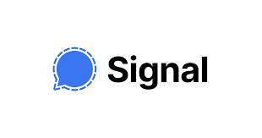
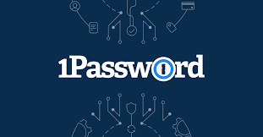
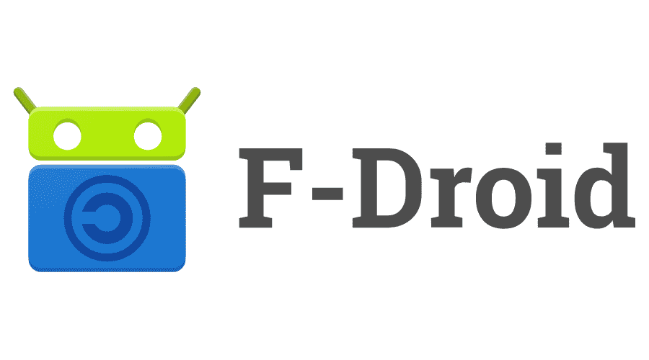
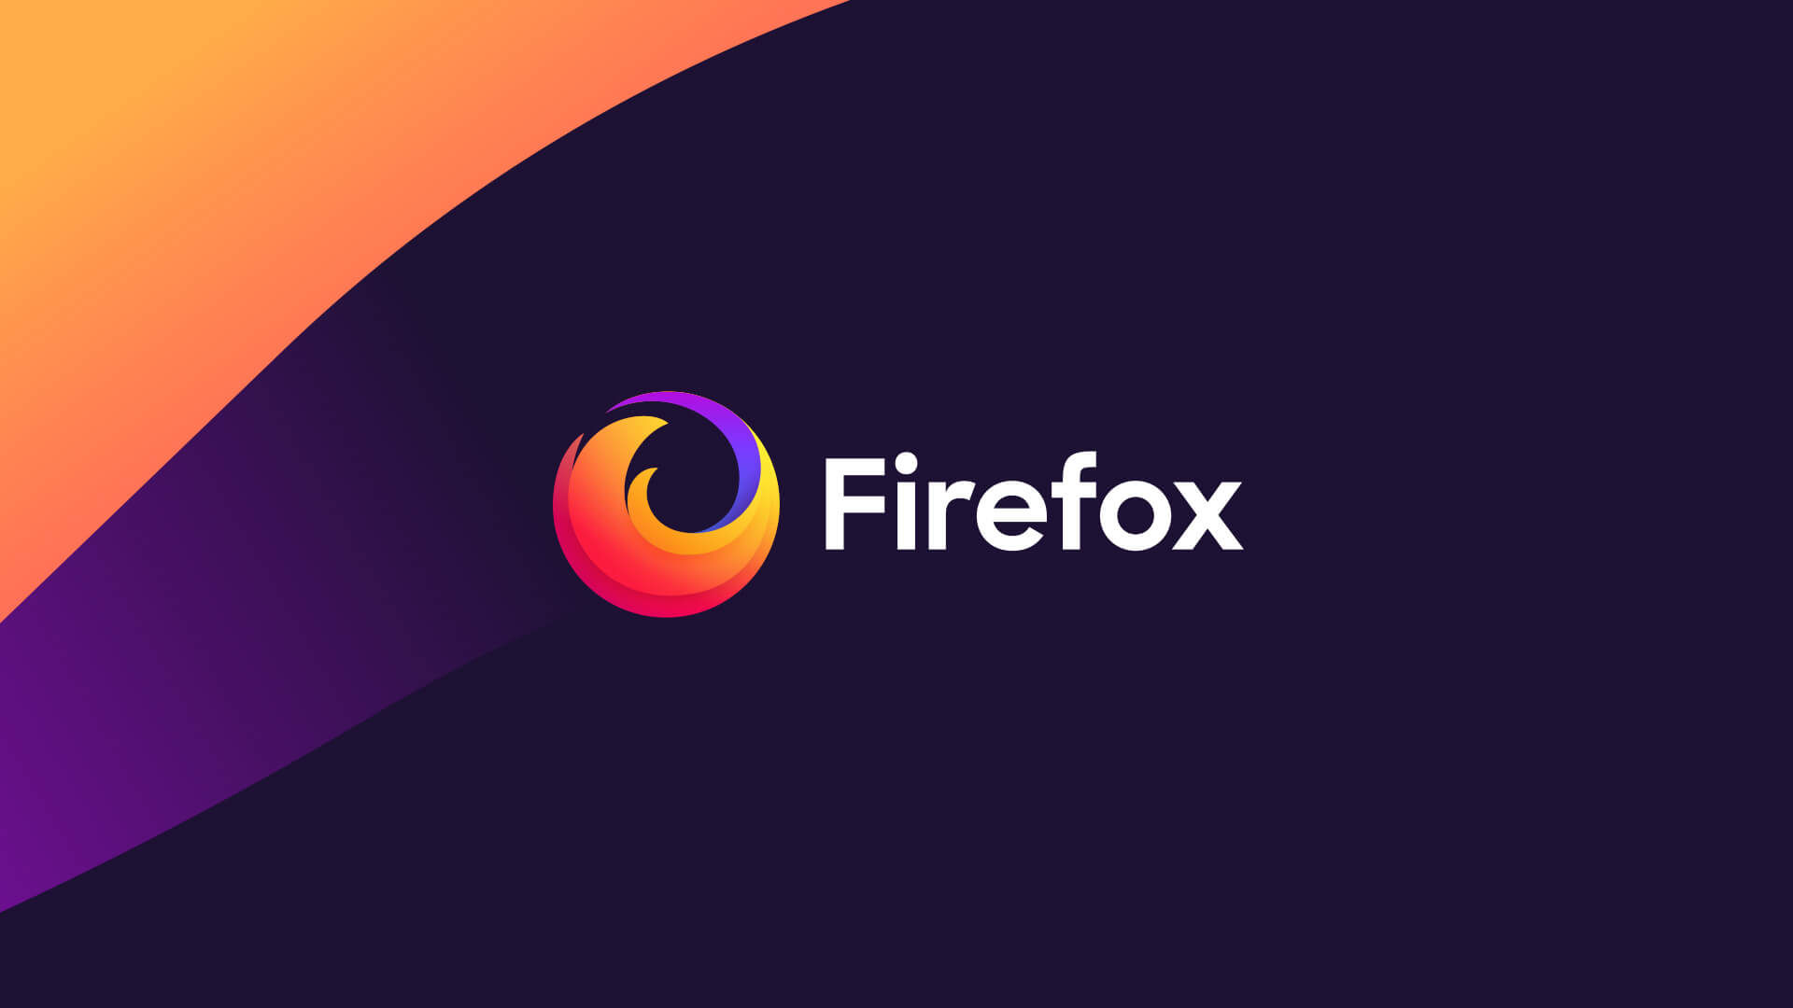


What do I use ?
Use at your own risk

Slide 22


What do I use ?

Slide 23

How To Make A SUPER-DUPER-ULTRA-MEGA-HYPER Strong Master Password?

Slide 24
Privacy is not there by default !
Notes:
It is up to you to take action and start to gain some privacy back to your life. We don’t have any to hide but when it does matter we can still hold that piece of information in our hand.

Slide 25
Reference
https://www.youtube.com/watch?v=6AXkJ3dot2s
https://www.youtube.com/watch?v=mz8-xeE7_I0

Slide 26
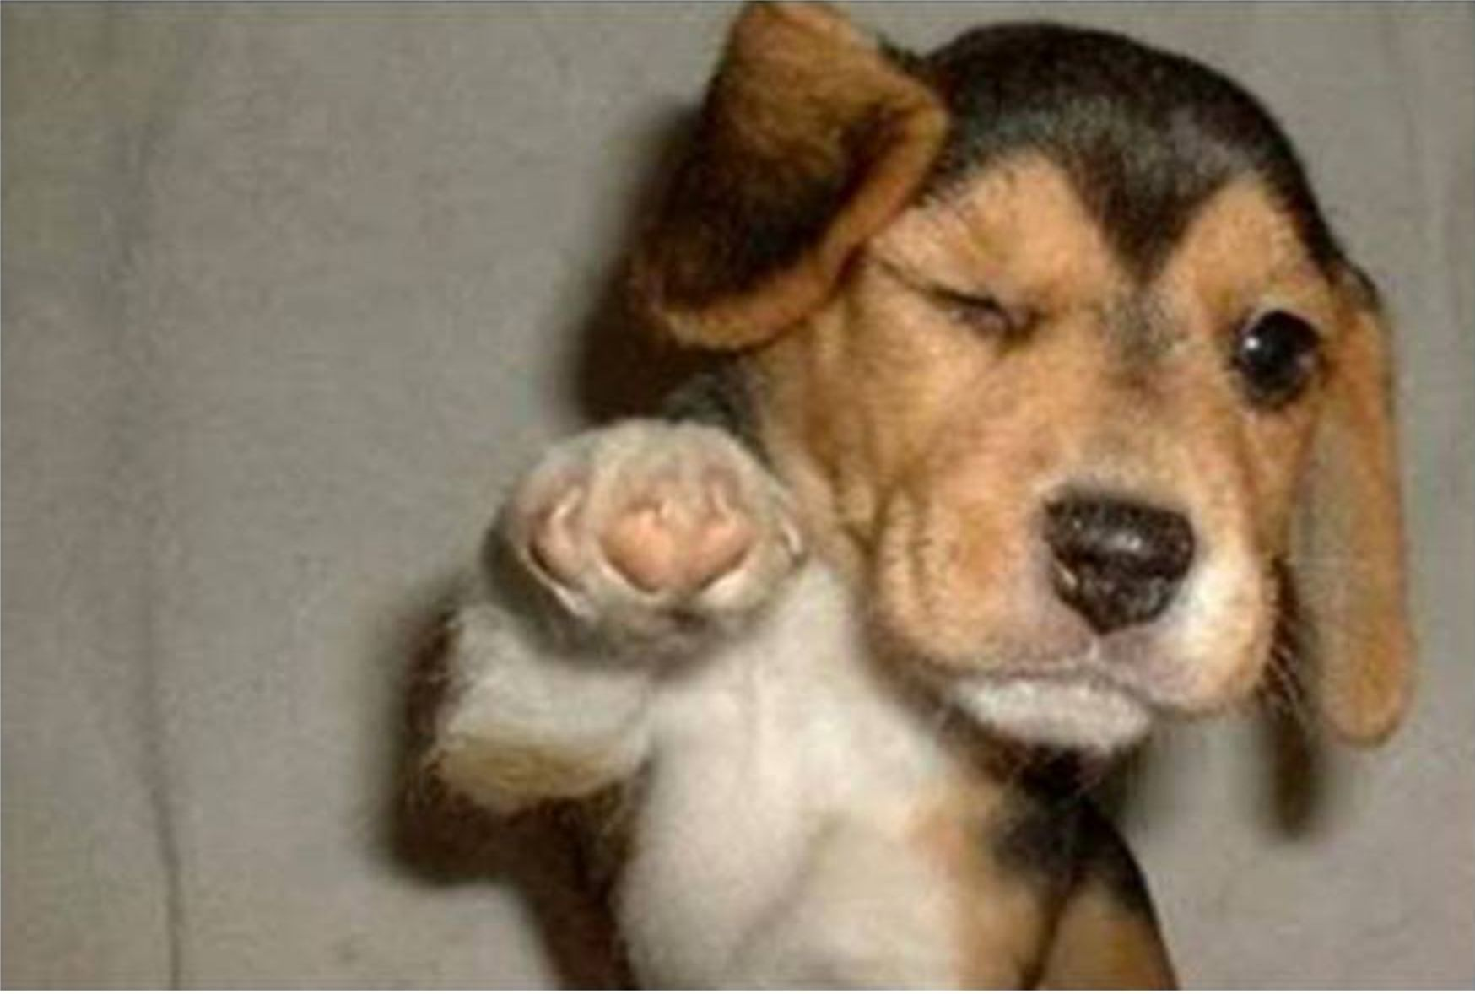
THANK YOU FOR LISTENING !

